Slide 1

Notes:
1st slide (Mandatory)

Slide 2
ARITHMATIC PROGRESSION,
GEOMETRIC PROGRESSION,
HARMONIC PROGRESSION.

Slide 3
ARITHMATIC PROGRESSION
Let 𝒂 and 𝒅 be real numbers. Then the numbers of the form 𝒂, 𝒂 + 𝒅, 𝒂 + 𝟐𝒅, 𝒂 + 𝟑𝒅, 𝒂 + 𝟒𝒅, . .. is said to form Arithmetic Progression denoted by A.P. The number ′𝒂′ is called the first term and ′𝒅′ is called the common difference.
𝒏 𝒕𝒉 𝒕𝒆𝒓𝒎 = 𝒕𝒏 = 𝒂 + (𝒏 − 𝟏)𝒅. The common difference of an A.P. we should subtract first term from the second term, second from the third and so on.

Slide 4
𝒅 = 𝒕𝒏 − 𝒕𝒏−𝟏
In a finite A.P. whose first term is 𝒂 and last term 𝒍, then the number of terms in the A.P. is given by 𝒍 = 𝒂 + (𝒏 − 𝟏)𝒅.
In an Arithmetic Progression,
• If every term is added or subtracted by a constant, then the
resulting sequence is also an A.P.
• If every term is multiplied or divided by a non – zero number, then
the resulting sequence is also an A.P.

Slide 5
• If the sum of three consecutive terms of an A.P. is given, then they can be taken as 𝒂 − 𝒅, 𝒂 and 𝒂 + 𝒅. Here the common difference is 𝒅.
• If the sum of four consecutive terms of an A.P. is given then, they can be taken as 𝒂 − 𝟑𝒅, 𝒂 − 𝒅, 𝒂 + 𝒅 and 𝒂 − 𝟑𝒅. Here common difference is 𝟐𝒅

Slide 6
ARITHMATIC PROGRESSION
1)If A = 1 - 10 + 3 -12 + 5 -14 + 7 + ... upto 60 terms, then
what is the value of A?
ANS:: -270
2) Find 5-8 + 13 +7 -11+ 17 +9 -14+21 + ........ upto 99
terms?
ANS:: 1914
3)What is the value of
100^2-99^2 + 98^2-97^2 + 96^2 -95^2 + 94^2-93^2 + ... + 12^2 -11^2?
ANS:: 4995

Slide 7
4)Find the sum of all two digit numbers which when divided
by 5 leaves a remainder 2 ?
ANS:: 981
5)What is the sum of all natural numbers between 100 and 400
which are divisible by 13?
ANS:: 5681
6)The 6th and 17th term of an arithmetic progression are 19
and 96 respectively .what is 25th term ?
ANS:: 152

Slide 8
7)Sum of first 25 terms of an AP is 525. Sum of the next 25 terms is 725. What is the common difference?
ANS:: 8/25
8)If 4 times the 4th term of an AP is equal to 18 times the 18th
term, then find the 22nd term?
ANS:: 0
9)If the sum of the first 100 terms of an arithmetic progression
is 50, and the sum of the first 200 terms is 90, then what is
the sum of the first 300 terms of the progression?
ANS:: 120

Slide 9
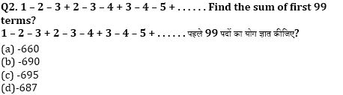
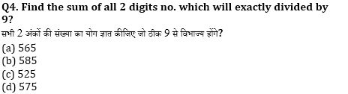
ANS:: A
ANS:: B

Slide 10
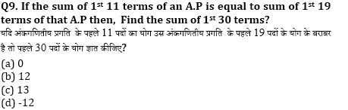
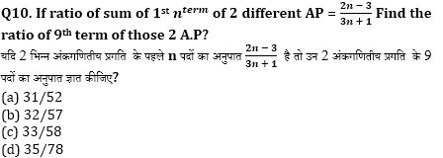
ANS:: A
ANS:: A

Slide 11
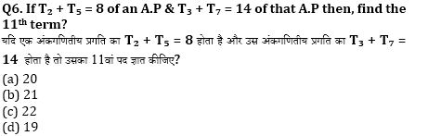
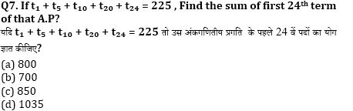
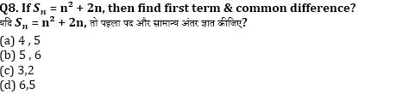
ANS:: D
ANS:: D
ANS:: C

Slide 12
GEOMETRIC PROGRESSION
A Geometric Progression is a sequence in which each term is obtained by multiplying is fixed non zero number to the preceding term except the first term. The first number is called common ratio. The common ratio is usually denoted by 𝒓.

Slide 13
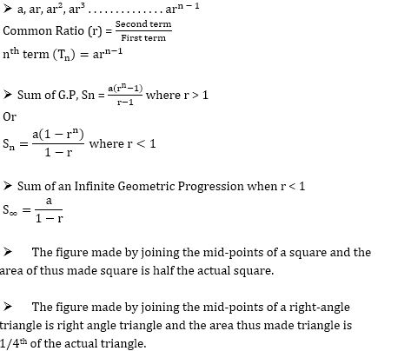

Slide 14
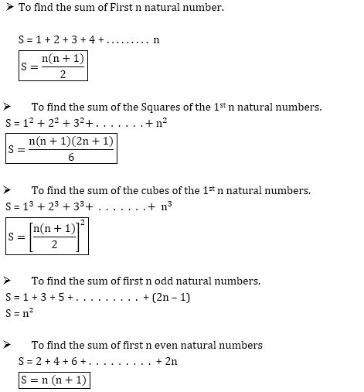

Slide 15
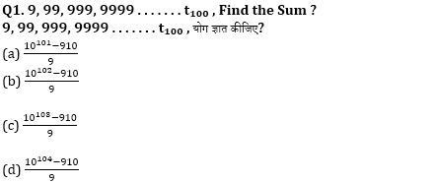
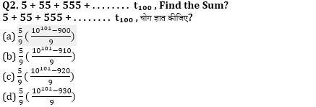
ANS:: A
ANS:: B

Slide 16
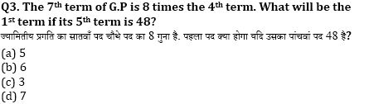
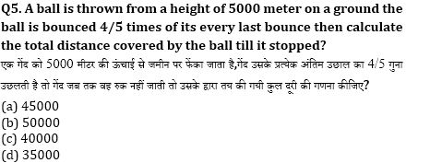
ANS:: C
ANS:: A

Slide 17
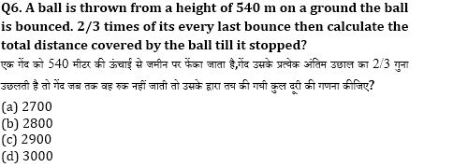
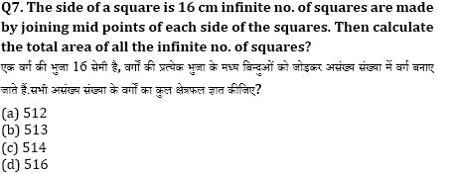
ANS:: A
ANS:: A

Slide 18
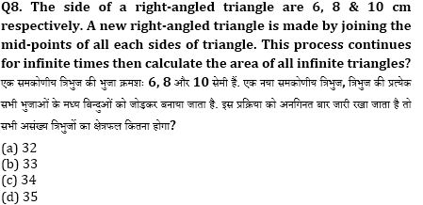
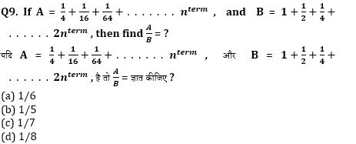
ANS:: A
ANS:: A

Slide 19
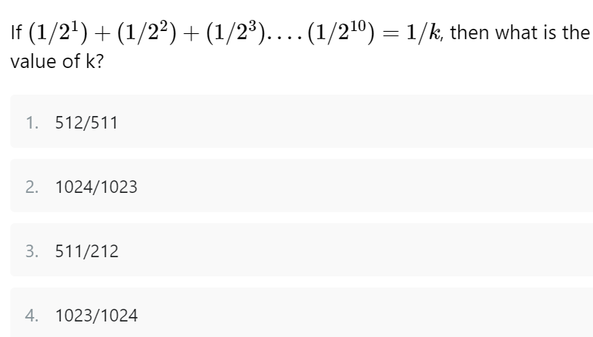
ANS:: 2

Slide 20
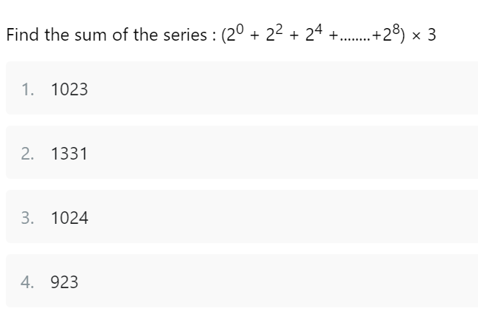
ANS:: 1

Slide 21
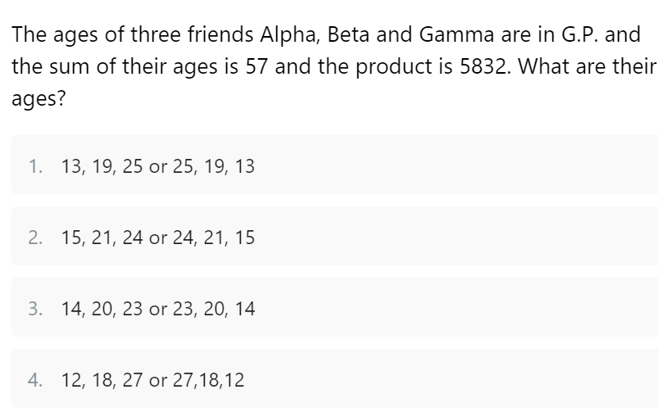
ANS:: 4

Slide 22
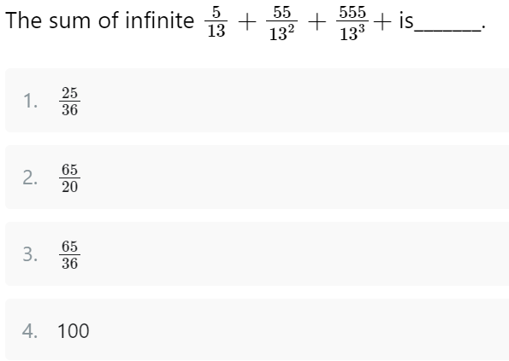
ANS:: 3

Slide 23
HARMONIC PROGRESSION
General term of harmonic progression can be represented as a reciprocal of progression that is in arithmetic form.
For representation of harmonic progression, an arithmetic progression is required and then after its reciprocal is done to convert it into harmonic progression.
Suppose a general form of an arithmetic progression is represented as a, b, c, d, e, f . . . then harmonic progression can be represented as 1/a, 1/b, 1/c, 1/d, 1/e, 1/f . . . . and so on.

Slide 24
Similarly, if terms of a sequence following arithmetic progression is given as “a, a + d, a + 2d, a + 3d, a + 4d,” . . . . And so on where “a” is first term and d is a common difference of arithmetic progression.
Then harmonic progression can be formulated as ” 1 / a, 1/(a+d), 1/(a+2d), 1/(a+3d), 1/(a + 4d), . . . . . .” and so on.
nth term of a H.P = 1 / [a + (n – 1)d]
Sum of n terms of H.P.; Sn = (1/d)ln {[2a + (2n – 1)d] / (2a – d)}.

Slide 25
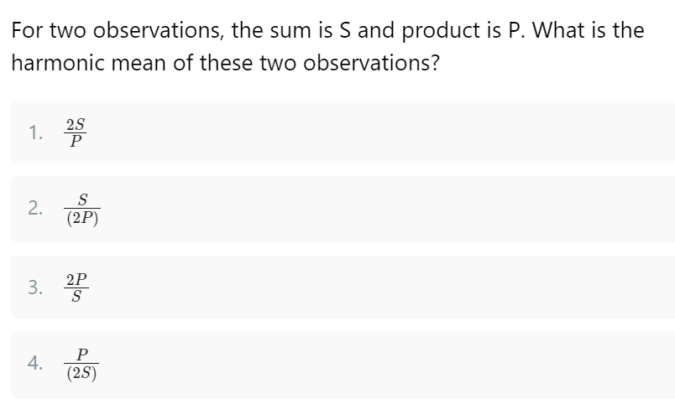
ANS:: 3

Slide 26
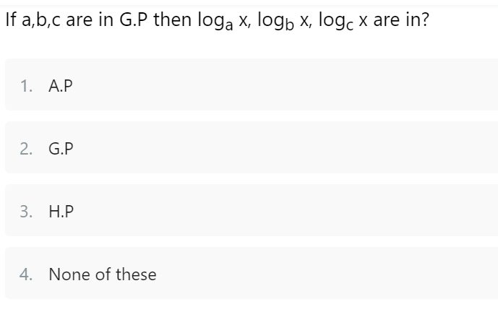
ANS:: HP

Slide 27
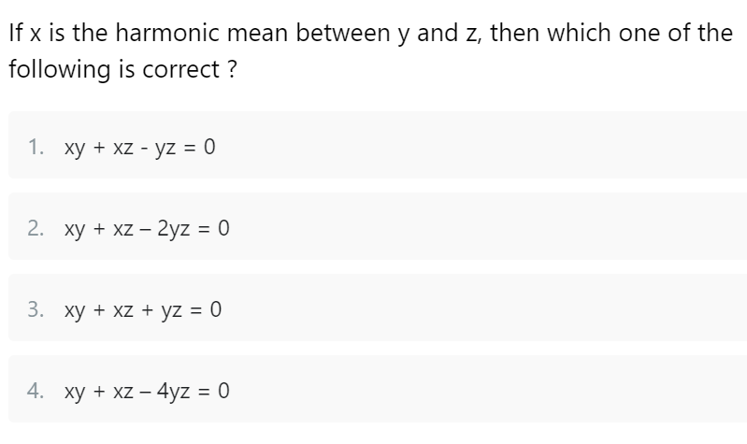
ANS:: 2

Slide 28
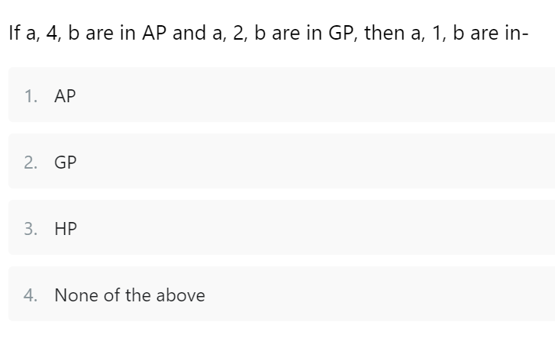
ANS:: 3

Slide 29
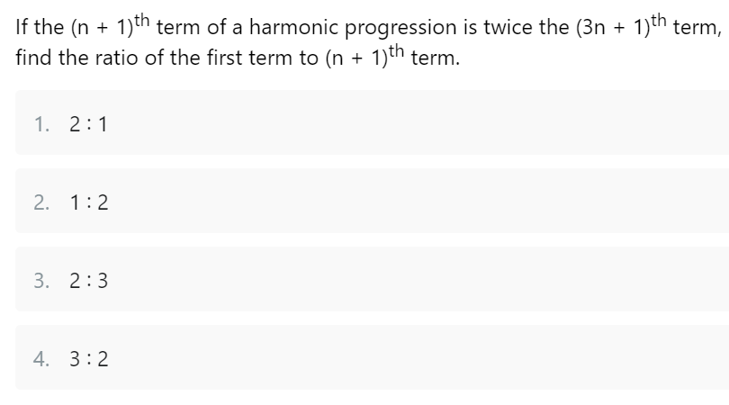
ANS:: 1

Slide 30
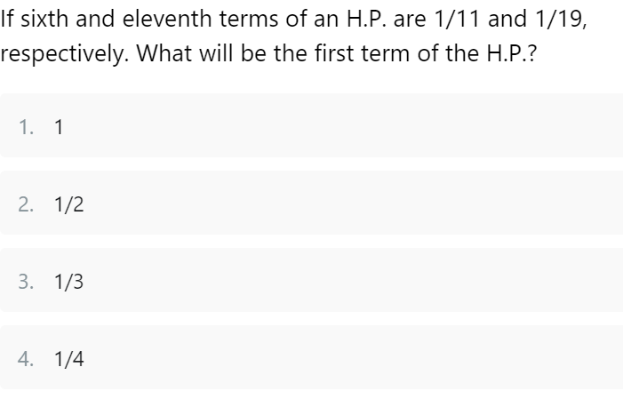
ANS:: 3

Slide 31
THANK YOU

